Slide 1
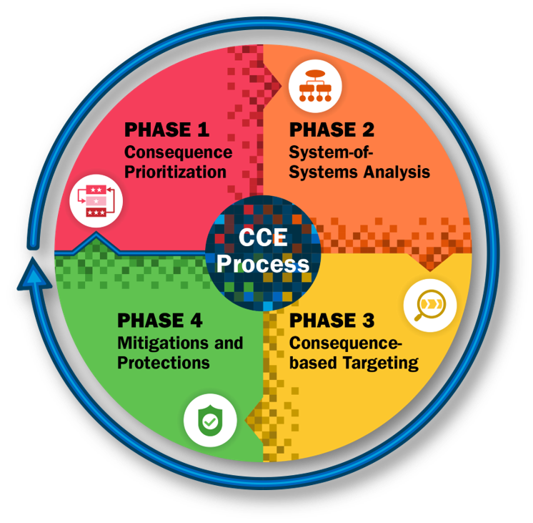


Countering Cyber Sabotage: Consequence-driven Cyber-informed Engineering (CCE) Methodology
Prashant Andrew Bochman
Linkedin: https://www.linkedin.com/in/prashantprofile/
Twitter: @prashant_geek
YegSec Slack: @guy_fawkes
Disclaimer: The views, thoughts, and opinions expressed in the talk belong solely to the author, and not necessarily to the author's employer, organization or any committee.
Notes:
Personal flavor of the Phase 1 on CCE for Enbridge and what I learnt from the engagement and how it can be beneficial to the audience. The why of this CCE presentation comes from motivation for CCE engagement in Enbridge.
I can speak out an overview of the topics coming due in the presentation.
This presentation is presell of the idea of CCE more than going deeper into the methodology itself, it is the WHY and not the HOW.

Slide 2
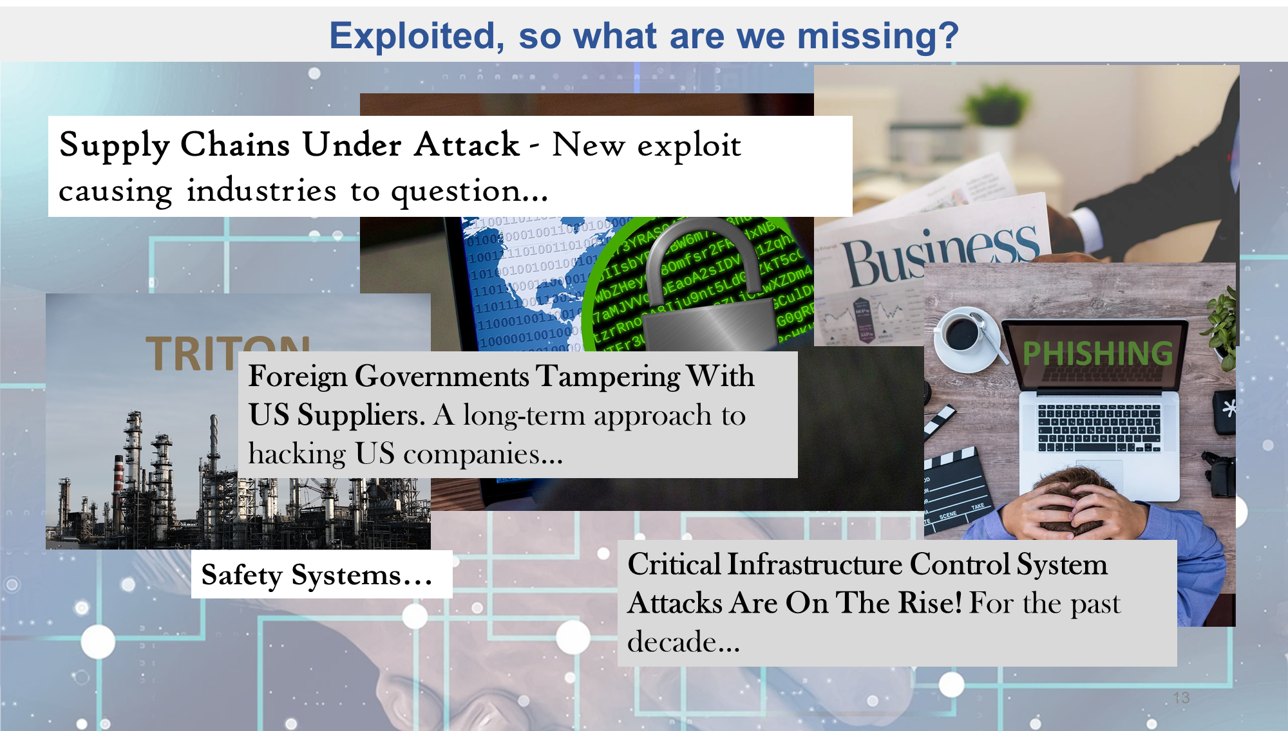
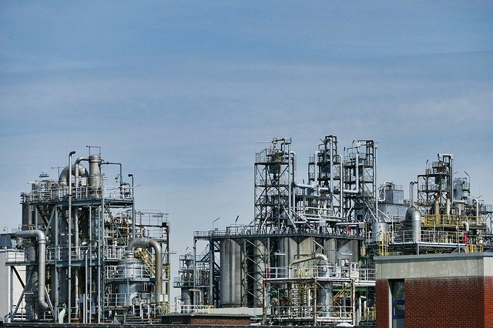
Critical Infrastructure Exploited– What are we missing?
Triconex SIS Malware
(Saudi Aramco ICS Malware, attacking Safety Instrumented Systems)

Slide 3
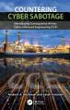
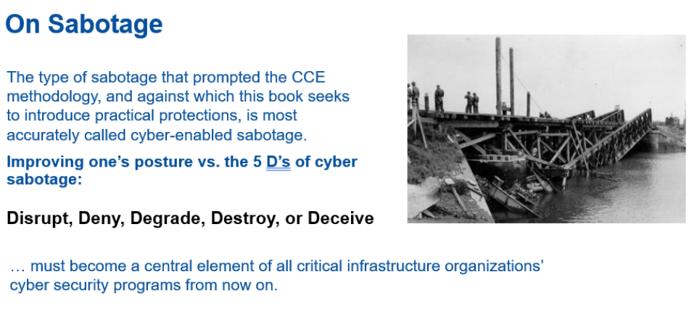
Sabotage: Cyber Twist

Slide 4
Risk Consideration
Cyber Sabotage
National
Security Risk
Business Risk
Basic Risk Management
Basic Risk Management
Addresses non-targeted malicious cyber activity
Floor you stand on for security

Slide 5

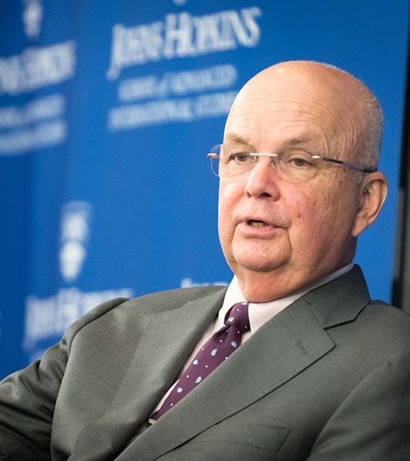
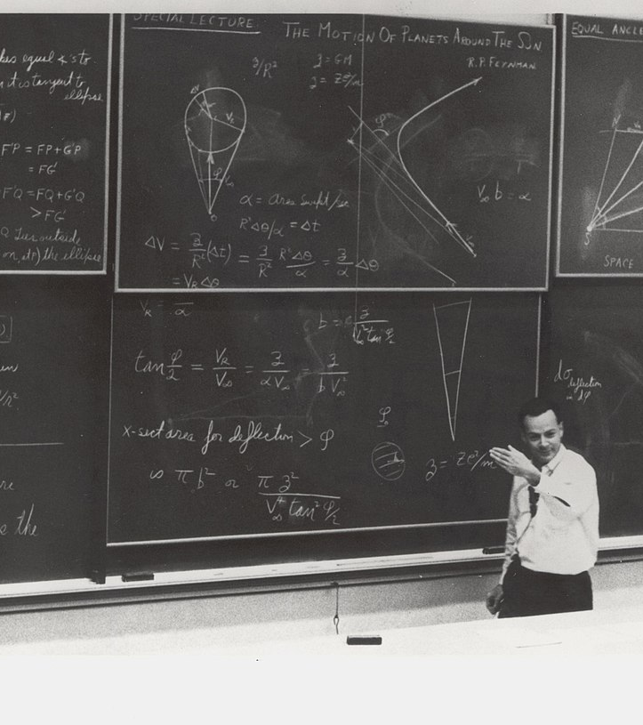
Cyber Defenders spend big time and money calculating LIKELIHOOD of COMPROMISE.
“They’re going to get in, get over it.”
– Michael Hayden
Former Director of CIA

Slide 6












Critical & Enabling Functions in Critical Infrastructure
Critical Functions
Enabling Functions
People
Infrastructure
People
Processes
Technologies

Slide 7
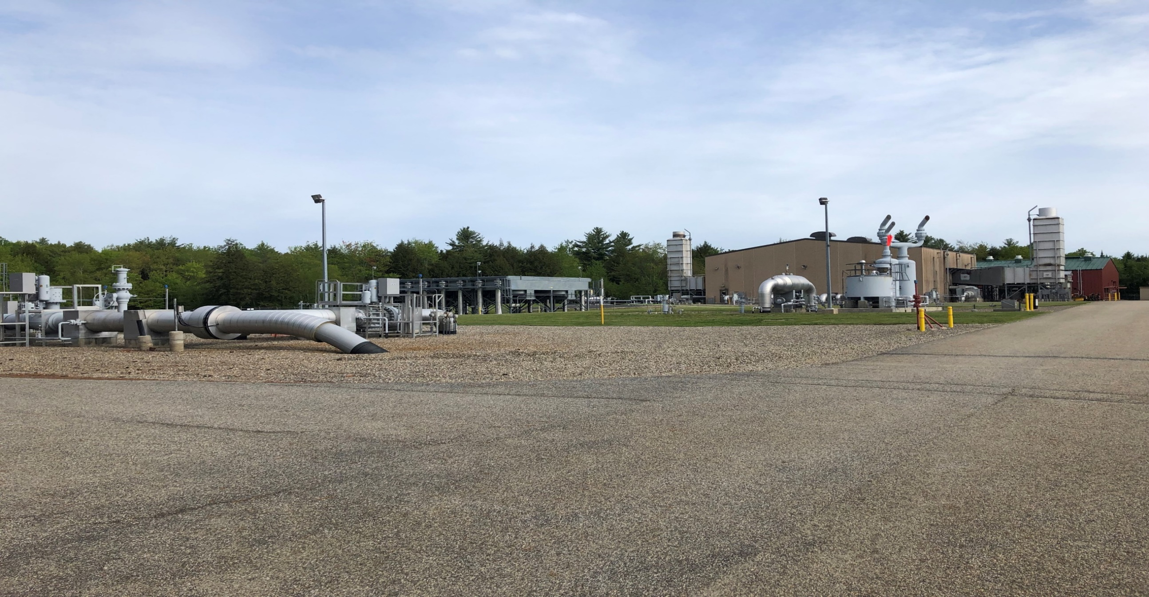
Critical Function: Delivery of Natural Gas Enabling Function: Typical Natural Gas Compressor Station
Attributes
Increase pressure and speed of gas
Monitor pressure of pipeline
Highly complex equipment
Applications/Devices
SCADA
HMI/PLC/RTU
Workhorse of the natural gas system and critical for maintaining deliveries.

Slide 8
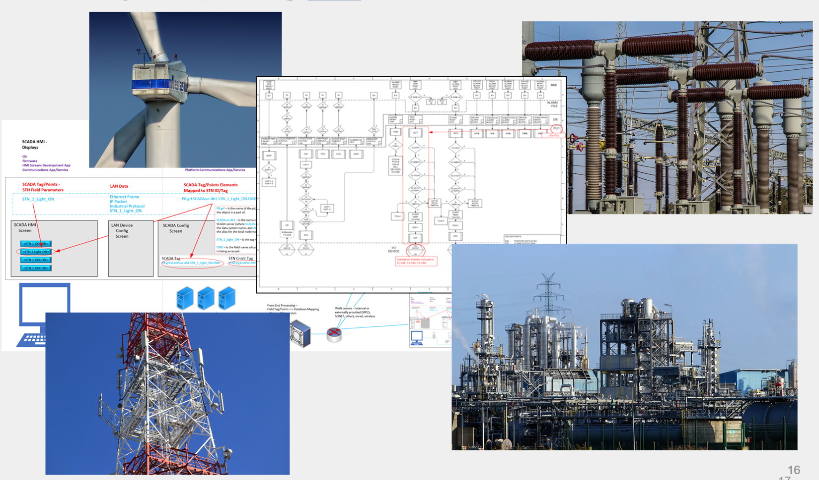
An adversary exploits our Enabling Functions AND impacts our Critical Functions.
Exploiting how we deliver our critical functions.

Slide 9
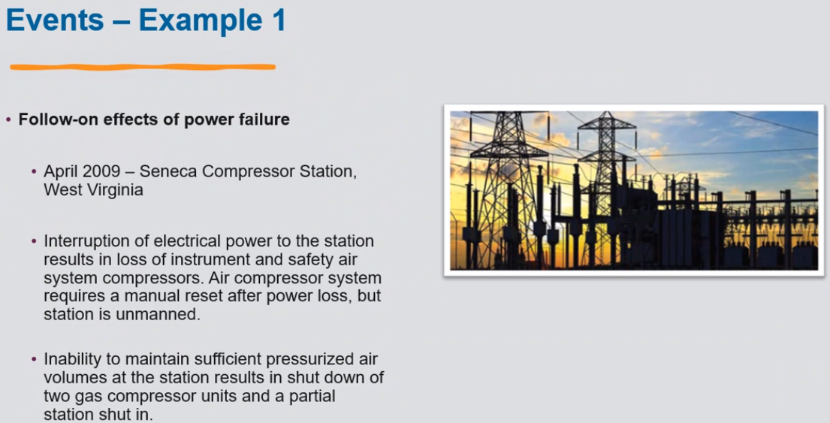
Pipeline and Hazardous Materials Safety Administration (PHMSA) examples

Slide 10

Vehicles for Cyber-enabled Sabotage
Cyber threat actors have an extensive collection of tools, methods, and resources to launch cyber attacks against enterprises.

Slide 11

CCE Baseline Assumptions
The adversary… (example of LIKEHOOD of breach=1)
has logical and physical access to victim’s environment
is knowledgeable
is well resourced and capable

Slide 12
Adversarial Methods
Service Providers
Product Vendors
System
The adversary is NOT limited to network-based cyber-attacks!
People
Network- Based Attacks

Slide 13



Misuse of Technology
Misuse of technology WILL IMPACT your Critical Functions.
Often, adversaries can manipulate existing systems and processes without creating new payloads or malware to carry out an attack.
(LIVING OF THE LAND Techniques)
Attack Requirements
Force a firmware update
Stop charging batteries
Open Breakers
Delete Backups
Existing Capabilities
Maintenance Mode
Battery charge scheduler
Substation remote HMI
Backup files stored on
network

Slide 14
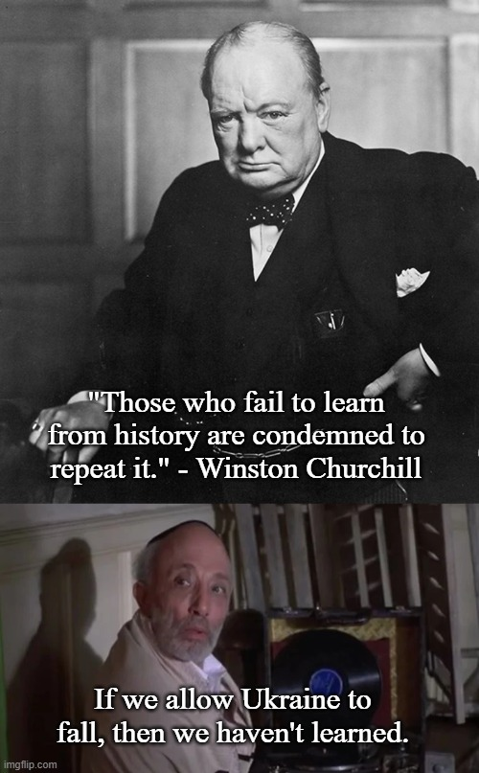


Examples of Misused Technology:
Ukraine 2015/2016 (Ukrenegro, Sandworm) – Florida Oldsmar Feb-2021 (HMI)

Slide 15


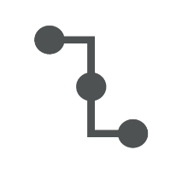


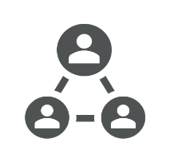




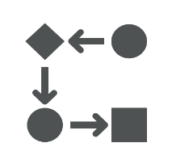



Unverified Trust
Cloud data vendor – how much access?
Who can access what?
Who accesses data from where?
Current process audited?
Firmware updates process and schedule?
Software updates process and schedule?
Subcontracted operators?
Employee backgrounds?
Subcontracted technicians?
Third-party printing services?
Who has access during compliance checks?
Supply chain?
Maintenance and support vendors?

Slide 16
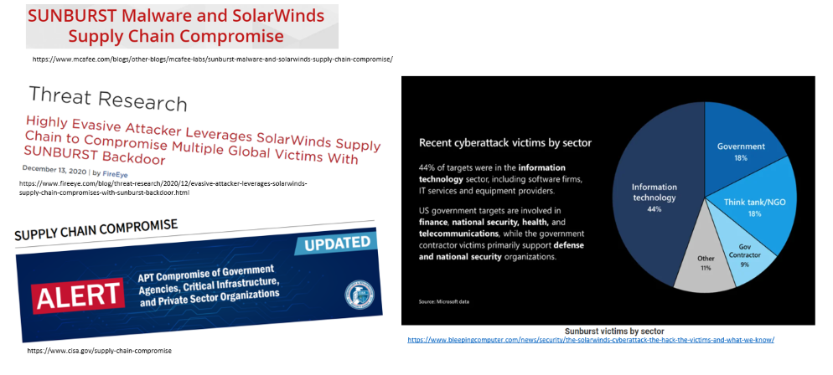
SolarWinds Supply Chain Attack (Third Party Risk)

Slide 17

What is the Solution?
Defender’s Advantage
The adversary will always know at least as much as you do about your technology―maybe even more.
But they won’t always know how you use your technology to deliver a critical function.
Perfect Knowledge
The understanding of how a critical function is uniquely implemented at an organization.

Slide 18
Consequence-driven Cyber-informed Engineering (CCE)
Methodology that guides organizations in identifying and mitigating catastrophic effects resulting from cyber-enabled sabotage.

Slide 19
CCE Overview
The goal of CCE is to protect critical functions from existing and emerging threats and proactively prepare for the next generation of cyber-enabled sabotage.

Slide 20
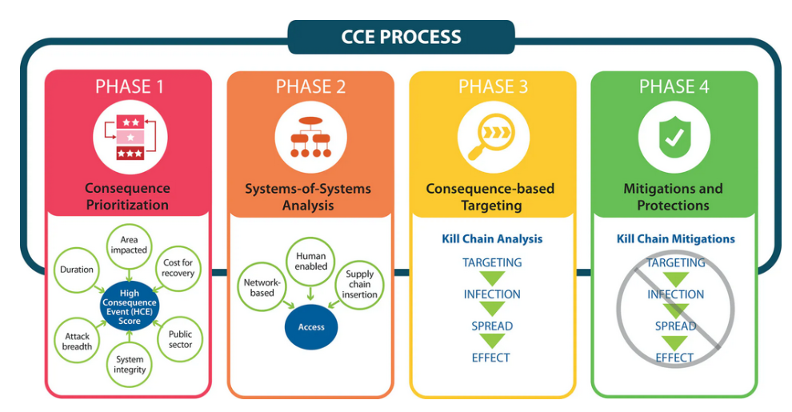

Slide 21
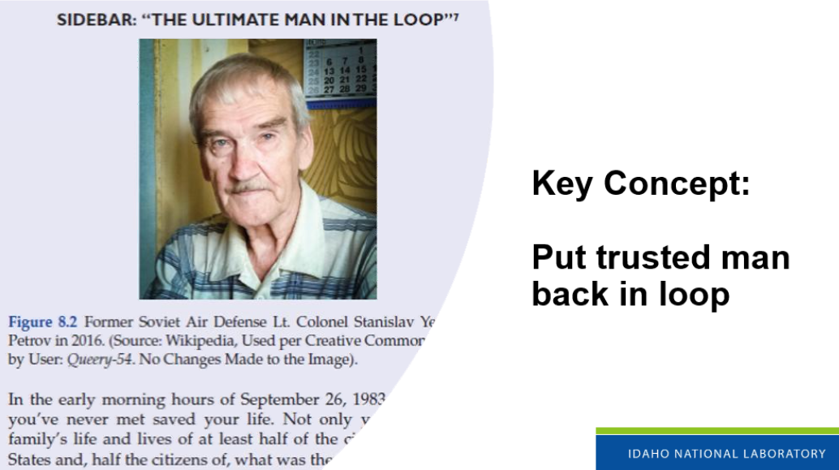

Slide 22
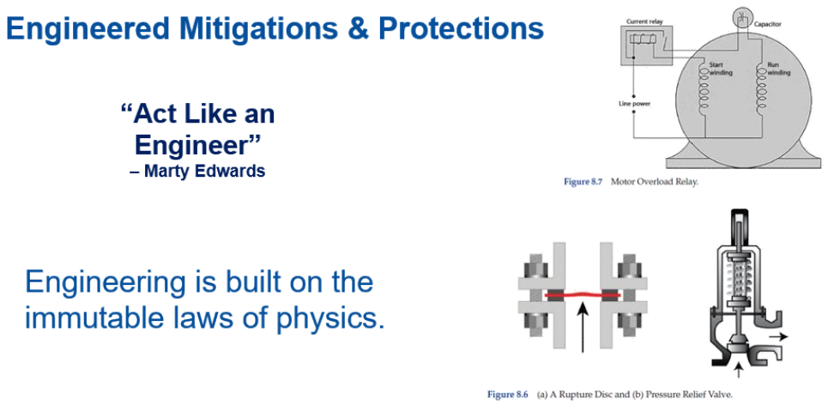
Notes:
Think like an Adversary but act like an Engineer
Cyber Defenses can be best enacted if you take an engineering mindset

Slide 23
Summary
Key Concepts
The adversary is targeting critical functions and how we deliver them.
Don’t blindly trust everything!
The adversary may know what your systems are, but not necessarily how they are uniquely implemented in your organization.
We have advantages that take the adversary years to acquire.
Always protect your data!
Key Terms
CCE
Critical Functions
Cyber-Enabled Sabotage
Unverified Trust
Perfect Knowledge
Data Protection

Slide 24
References:
INL website on CCE: https://inl.gov/cce/
S4 conference in 2019 on CCE: https://www.youtube.com/watch?v=hfo_6t043aw
Engineering Out the Cyber-Risk to Protect What Matters Most
https://www.youtube.com/watch?v=R5o-t33nWoA
AHC2022 Consequence driven Cyber informed Engineering CCE
https://www.youtube.com/watch?v=V1qhFz8rAuo
https://vimeopro.com/midwestreliability/videos/video/474780901

Slide 25

Questions

